Slide 1
Sprint #1
By: Team_Four_Star

Slide 2
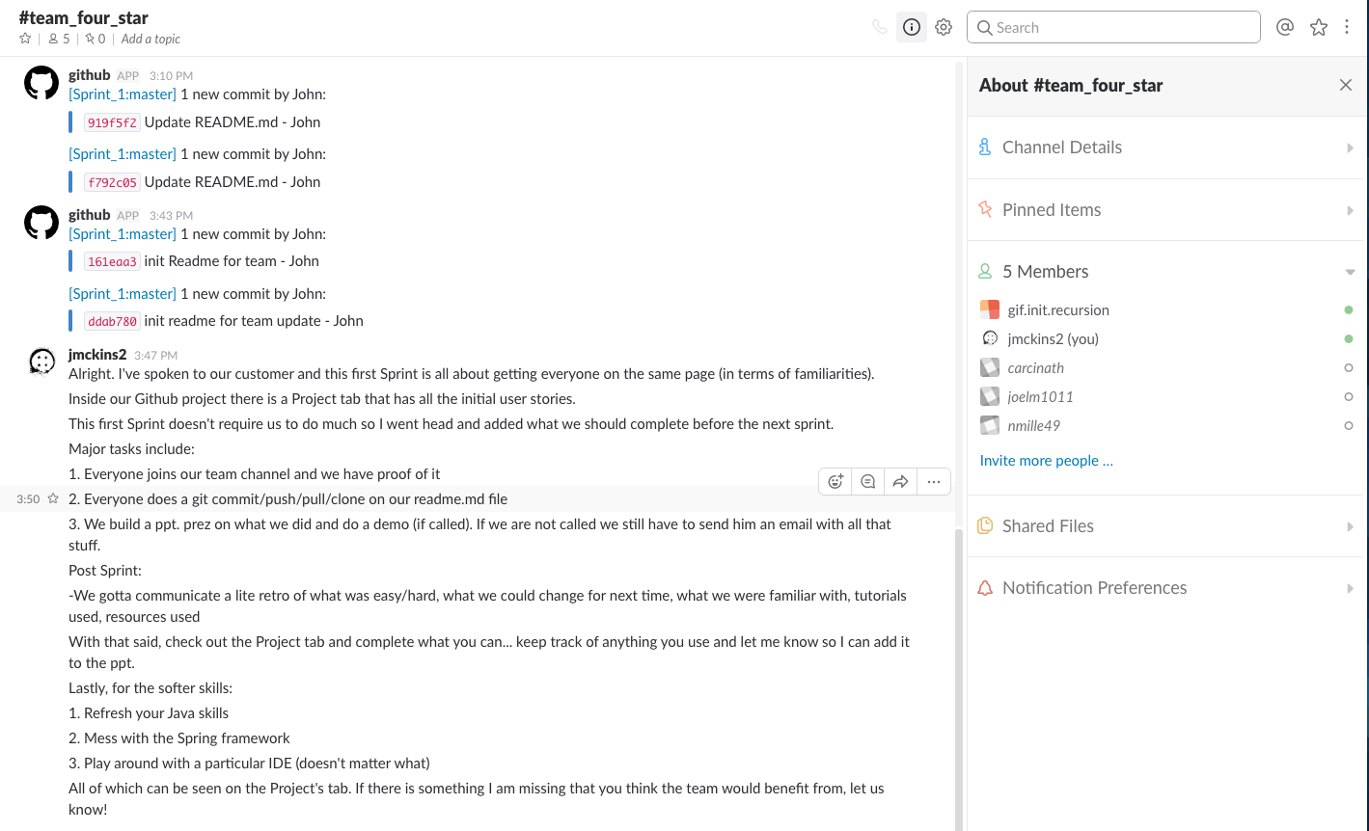
Team Members

Slide 3
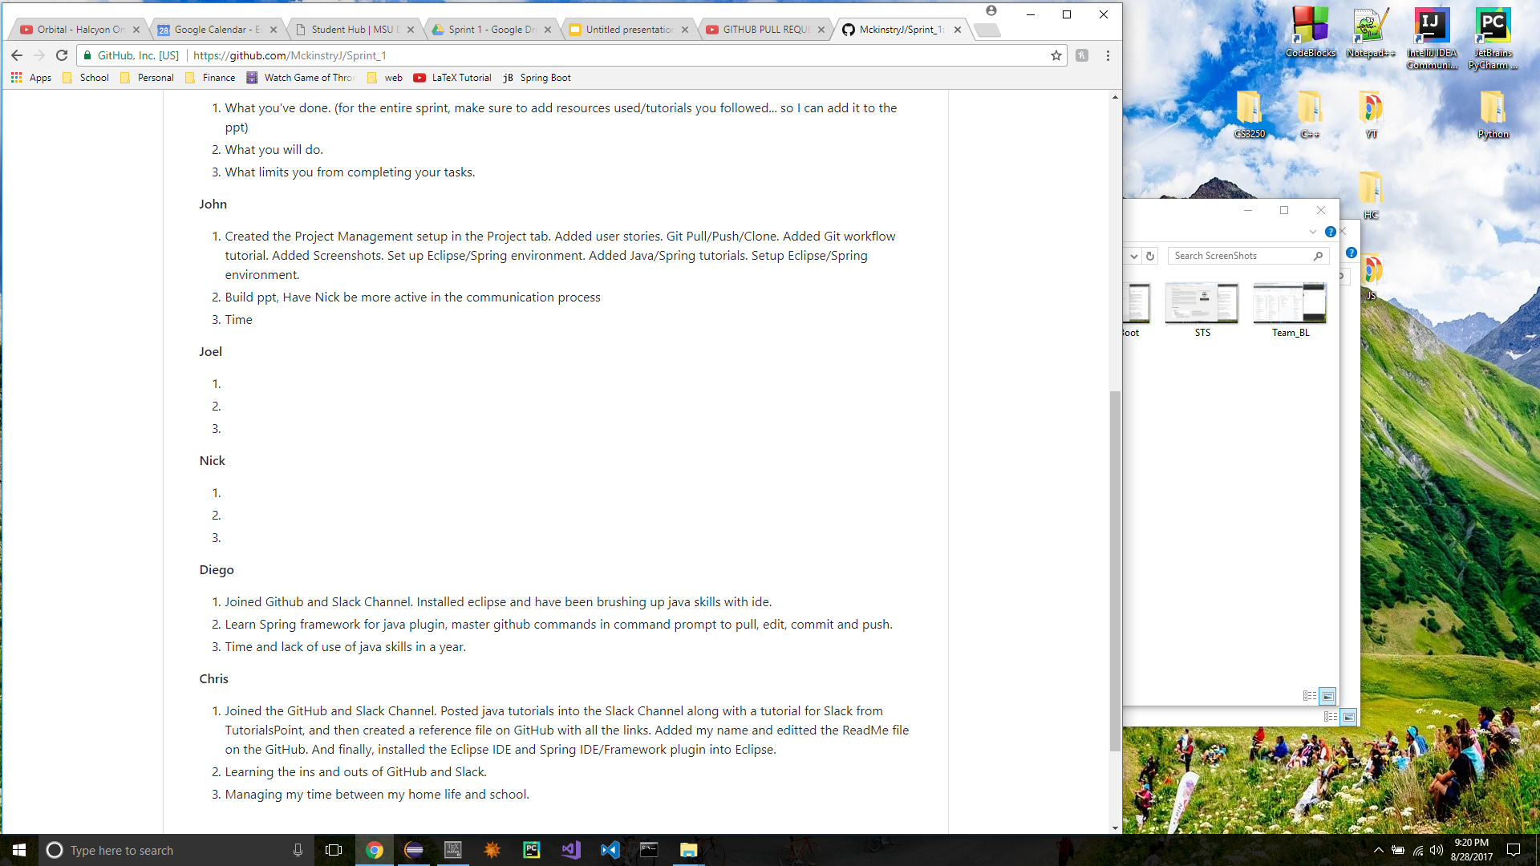
Team ReadMe Commits

Slide 4
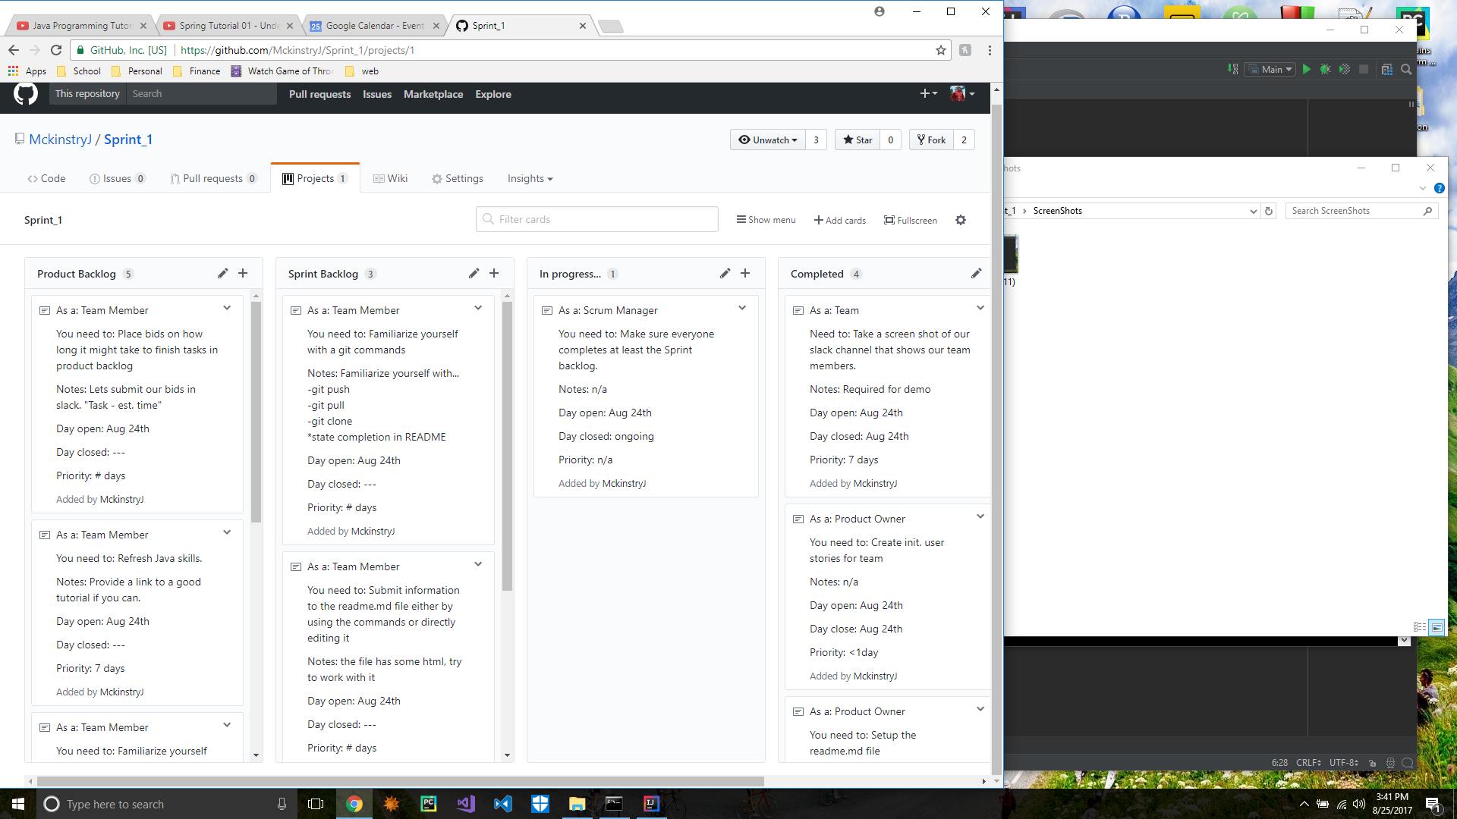
Team Backlog

Slide 5
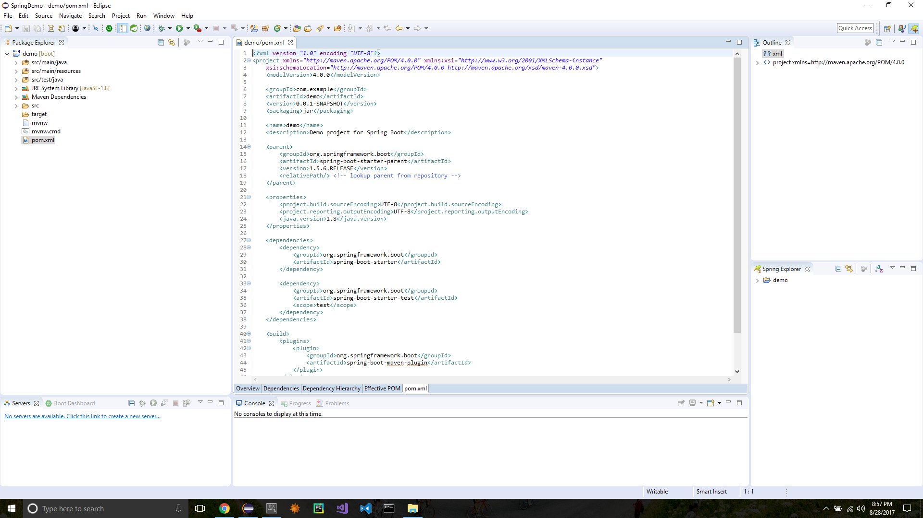
Eclipse IDE and STS Plugin

Slide 6
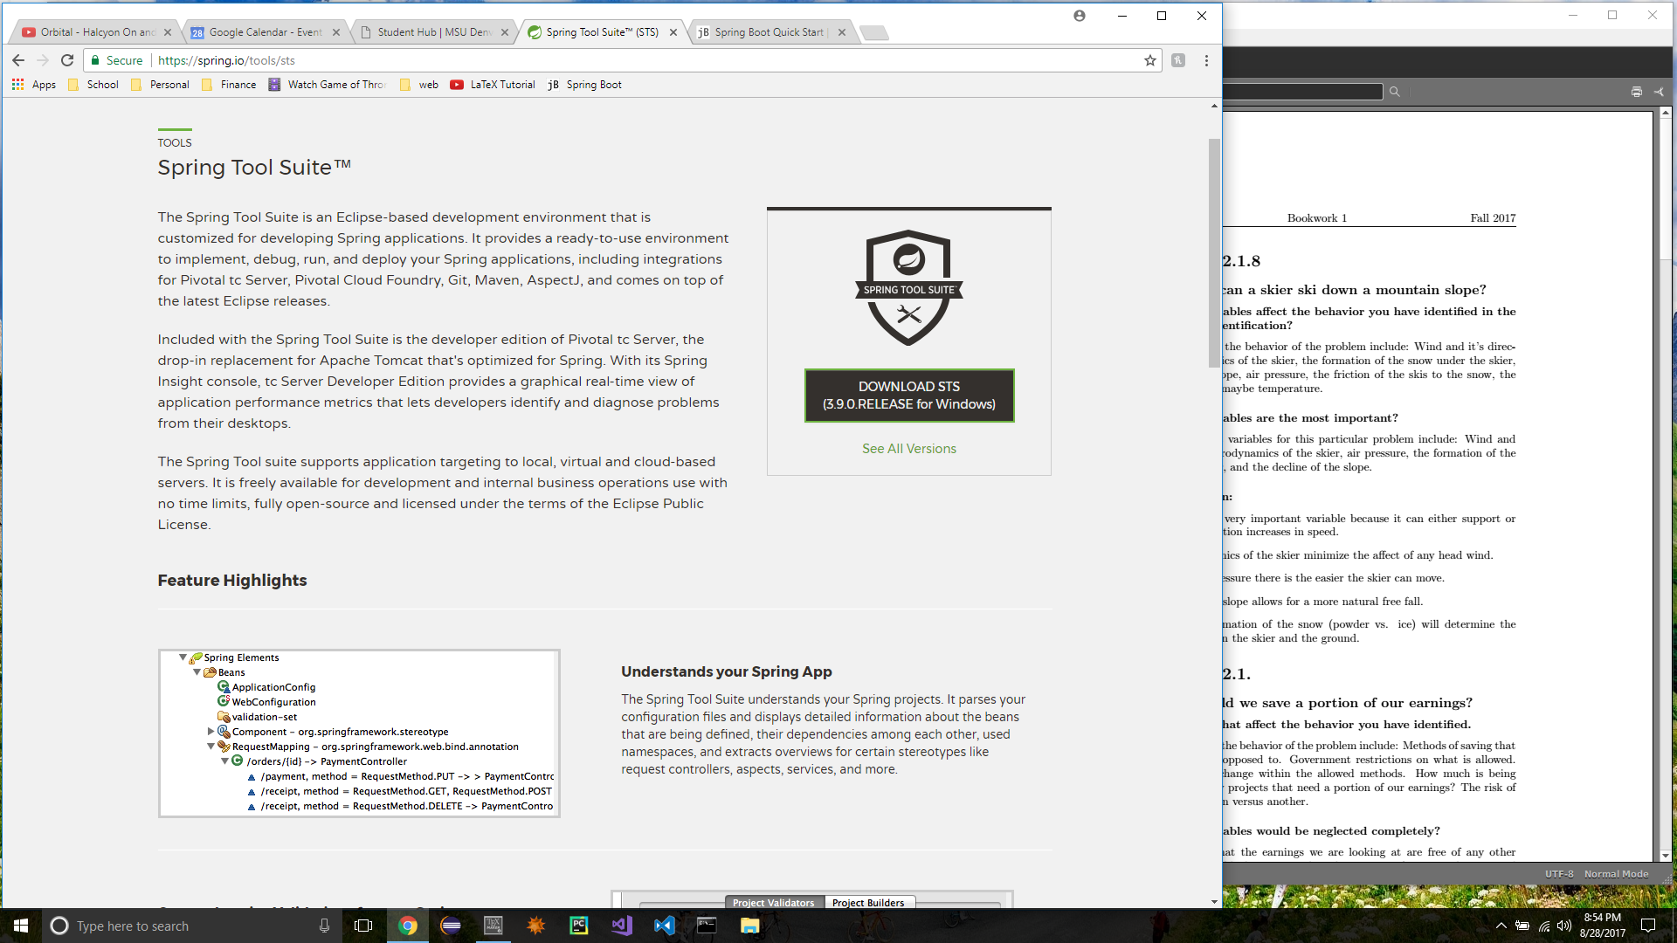
Spring Tool Suite

Slide 7
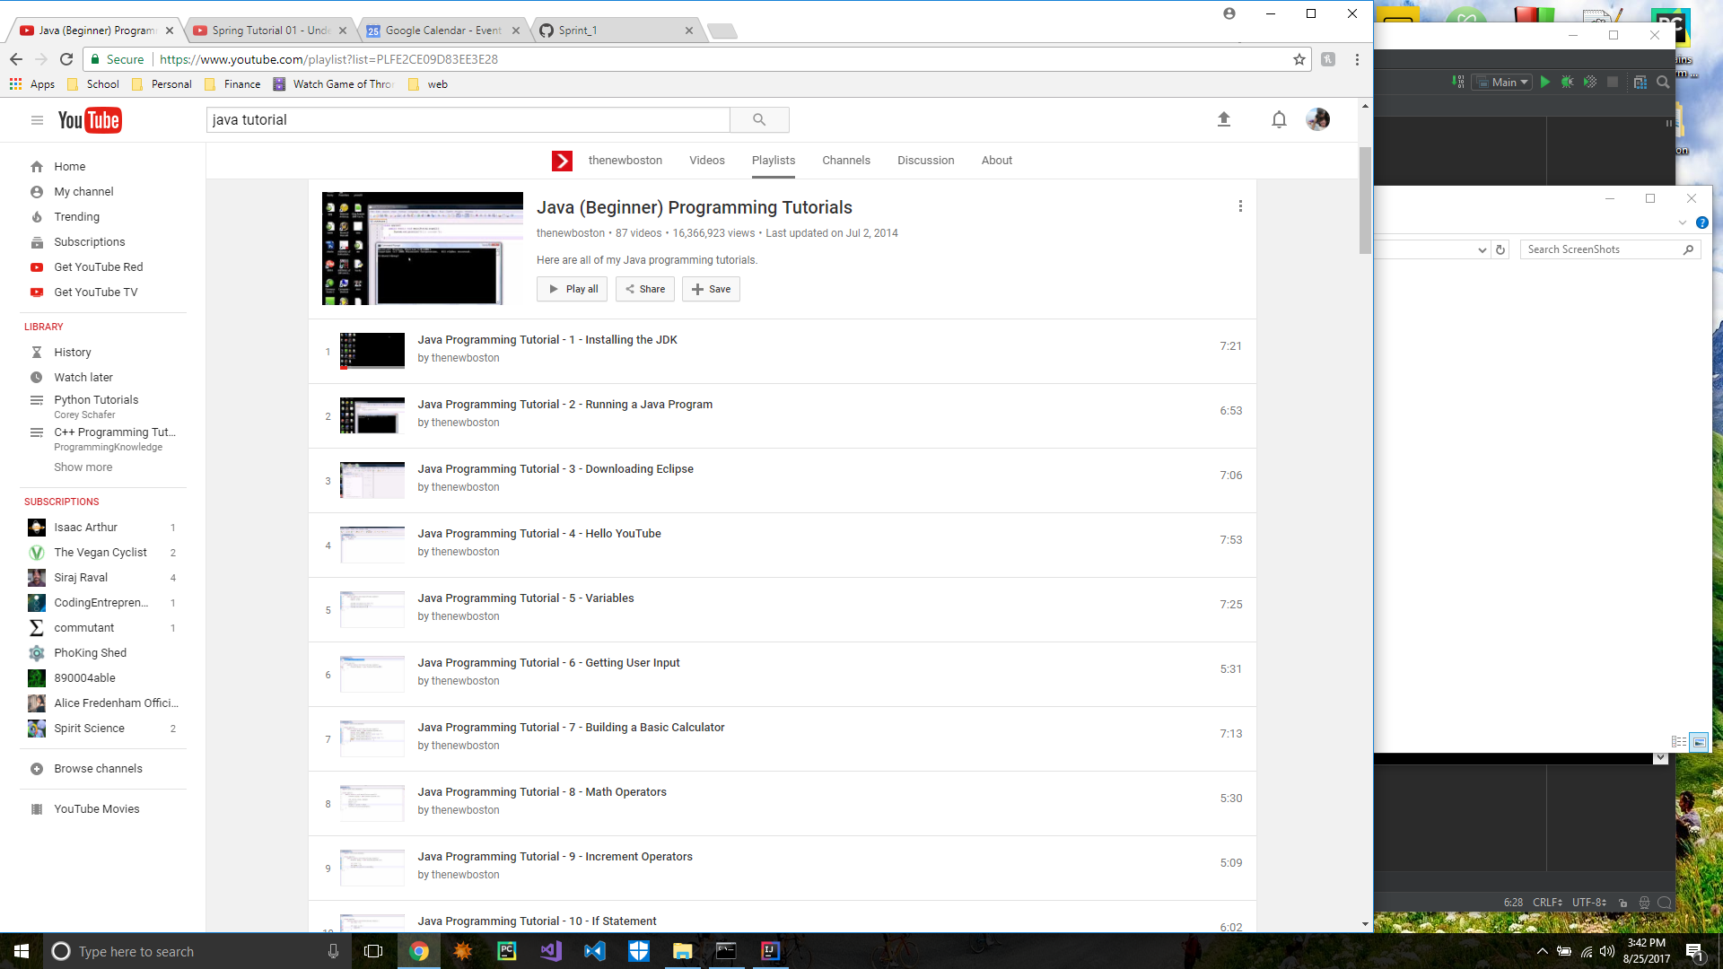
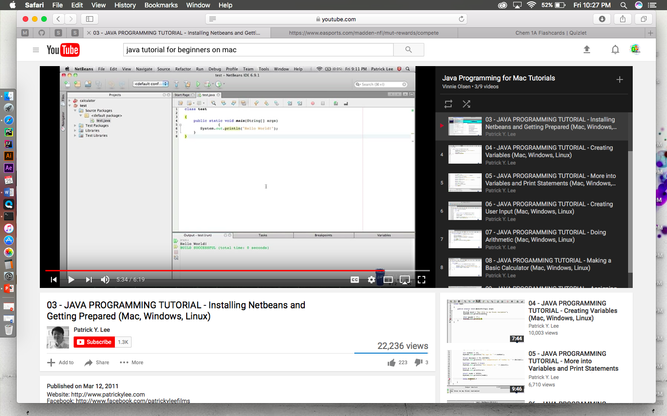
Java Tutorials

Slide 8
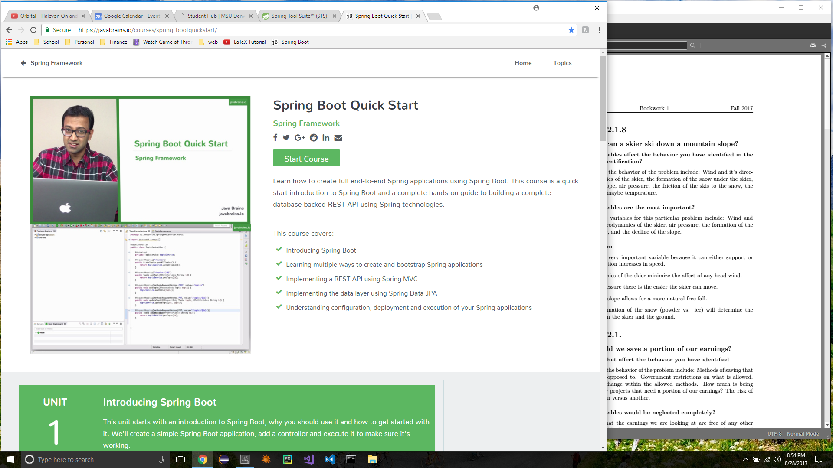
Spring Boot Tutorial

Slide 9
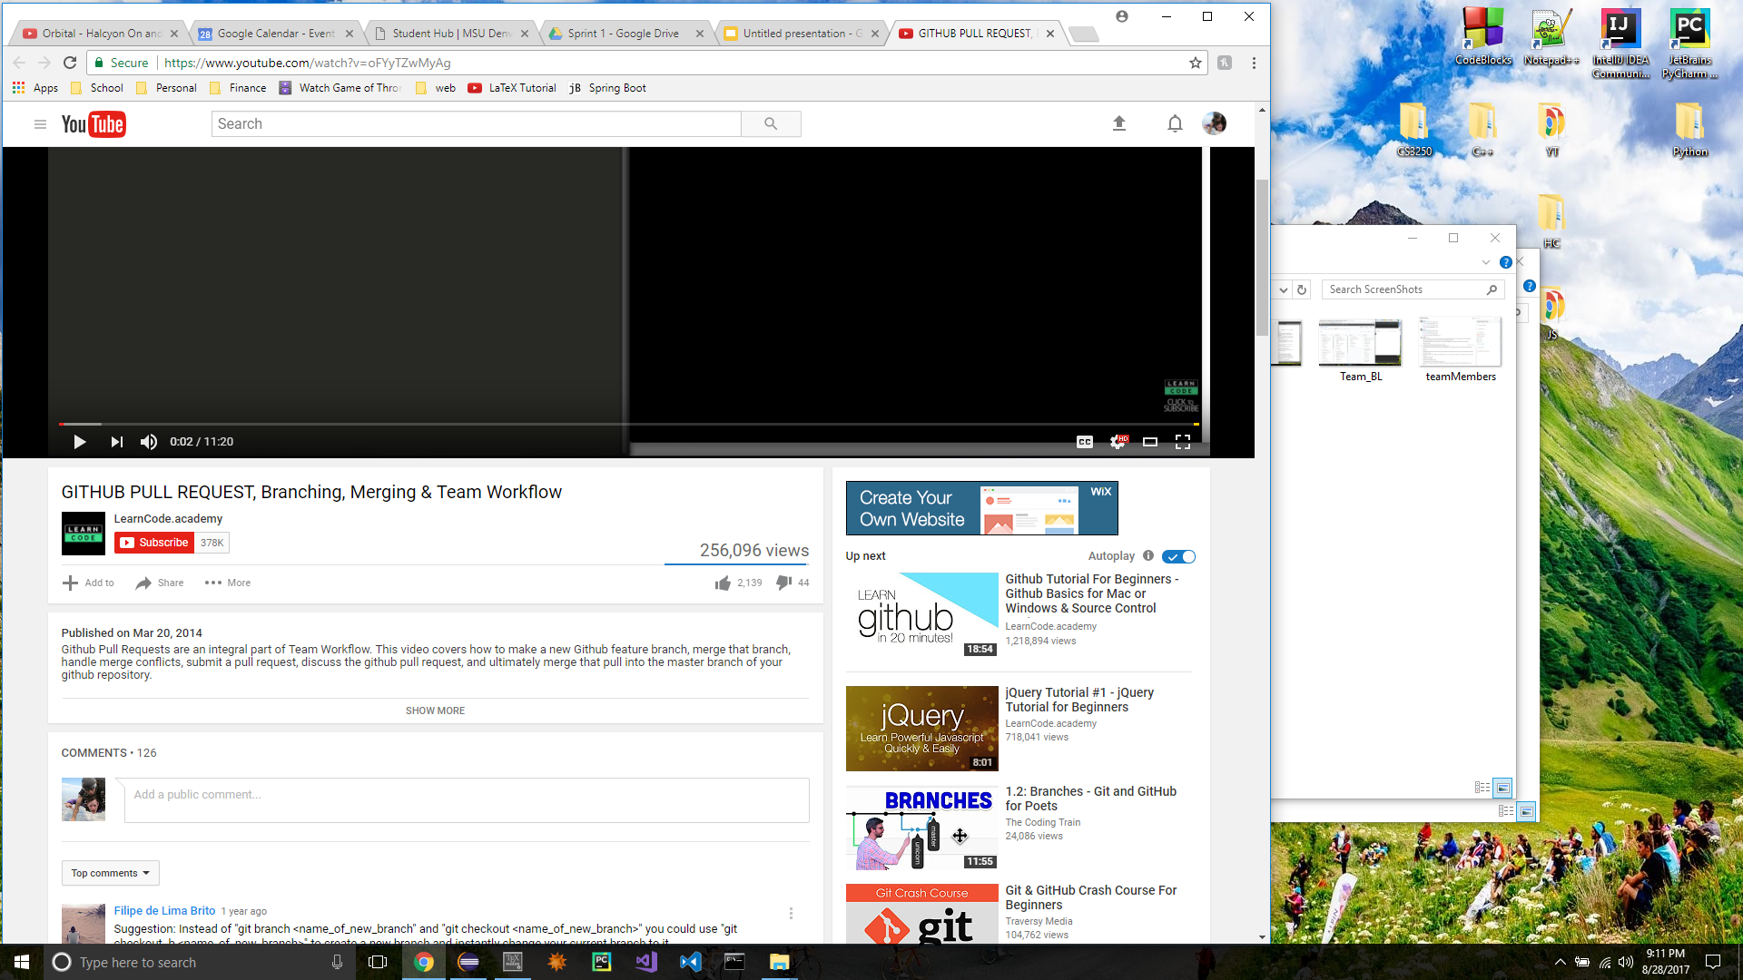
Github Tutorials

Slide 10
Light Retro
What was easy/hard?
What to change?
Familiar with what?
Other Resources used?

